Slide 1

Group Dynamics: its characteristics, stages, types and factors

Slide 2
What is Group Dynamics?
Group dynamics deals with the attitudes and behavioural patterns of a group.
Group dynamics concern how groups are formed, what is their structure and which processes are followed in their functioning.
It is concerned with the interactions and forces operating between groups.

Slide 3
What is A Group?
Every organization is a group unto itself.
A group refers to two or more people who share a common meaning and evaluation of themselves and come together to achieve common goals. In other words, a group is a collection of people who interact with one another; accept rights and obligations as members and who share a common identity.

Slide 4
Characteristics of a Group:
(a) 2 or more persons
(b) Formal social structure
(c) Common fate
(d) Common goals
(e) Face-to-face interaction
(f) Interdependence
(g) Self-definition as group
(h) Recognition by others

Slide 5
Process/Stages of Group Development:
Five stages: forming, storming, norming, performing, and adjourning.
Forming: Seeking work assignment
Storming: Begin a deeper sharing of self(conflict )
Norming : More serious concern about task performance, take greater responsibility, clear picture
Performing: Fully functional group
Adjourning: Temporary groups, like project team, task force, or any other such group, which have a limited task at hand. The group decides to disband.

Slide 6
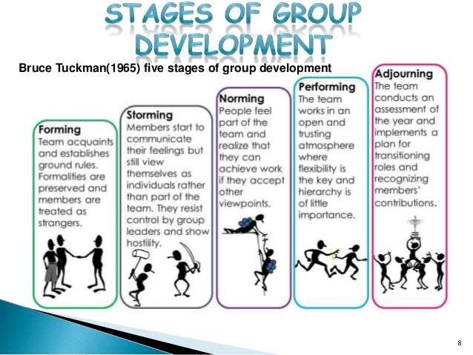
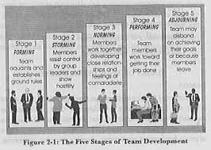

Slide 7
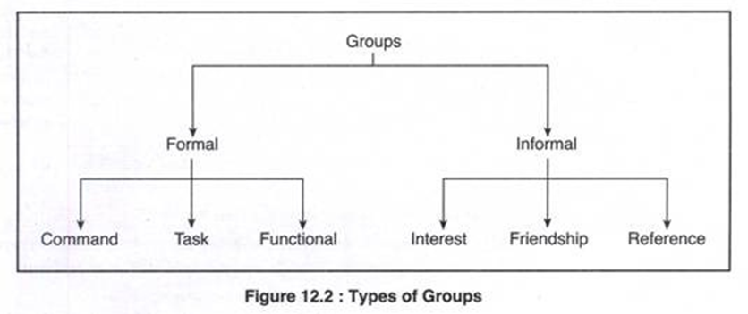

Slide 8
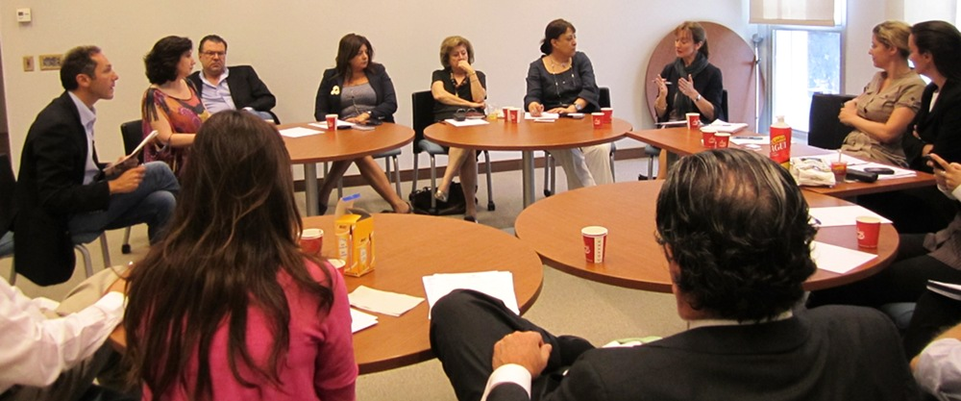
Types of Groups:
Formal and informal : formal groups are established by an organization to achieve its goals, informal groups merge spontaneously
Formal groups- command groups, task groups, and functional groups.

Slide 9
1. Command Groups: Consist of a supervisor and the subordinates that report to that supervisor.
2. Task Groups : Organization appoints members and assigns the goals and tasks to be accomplished. (Designing the syllabus under semester system)
3. Functional Groups: A functional group is created by the organization to accomplish specific goals within an unspecified time frame.(accounting department)

Slide 10
Informal groups
i. Interest Group:
Interest groups usually continue over time and may last longer than general informal groups.(organizational department)
ii. Friendship Groups:
Friendship groups are formed by members who enjoy similar social activities, political beliefs, religious values, or other common bonds. (yoga group)
iii. Reference Groups:
A reference group is a type of group that people use to evaluate themselves.
Notes:
A reference group is a type of group that people use to evaluate themselves. The main objectives of reference groups are to seek social validation and social comparison. Social validation allows individuals to justify their attitudes and values while social comparison helps individuals evaluate their own actions .

Slide 11
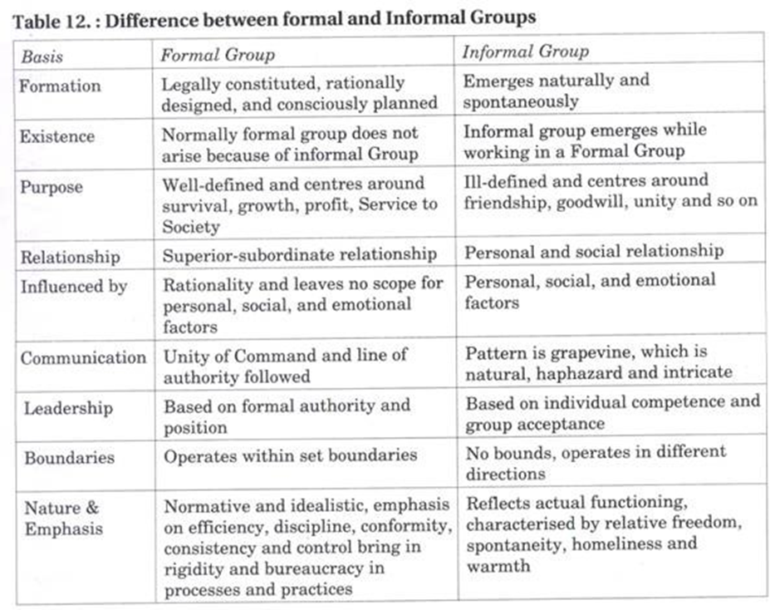

Slide 12
Characteristics of Informal Groups:
Creation, Satisfaction of Needs, Voluntary Membership, Multi-Group Membership, Systems and Processes, Leadership.
Benefits of Informal Groups:
Blending with formal group, Brings satisfaction and stability to the organisation as a whole, Provides a useful channel of communication, Encourages managers to plan and act more carefully.
Limitations of Informal Groups:
Resistance to Change, fertile ground for Rumour, lack of proper communication, Since a member of an informal group is also a member of a formal group, at times it creates role conflict.

Slide 13
Factors Affecting Group Behaviour:
The success or failure of a group depends upon so many factors.
Group member resources, structure (group size, group roles, group norms, and group cohesiveness), group processes (the communication, group decision making processes, power dynamics, conflicting interactions, etc.) and group tasks (complexity and interdependence).

Slide 14
1. Group Member Resources:
The members’ knowledge, abilities, skills; and personality characteristics (sociability, self- reliance, and independence)

Slide 15
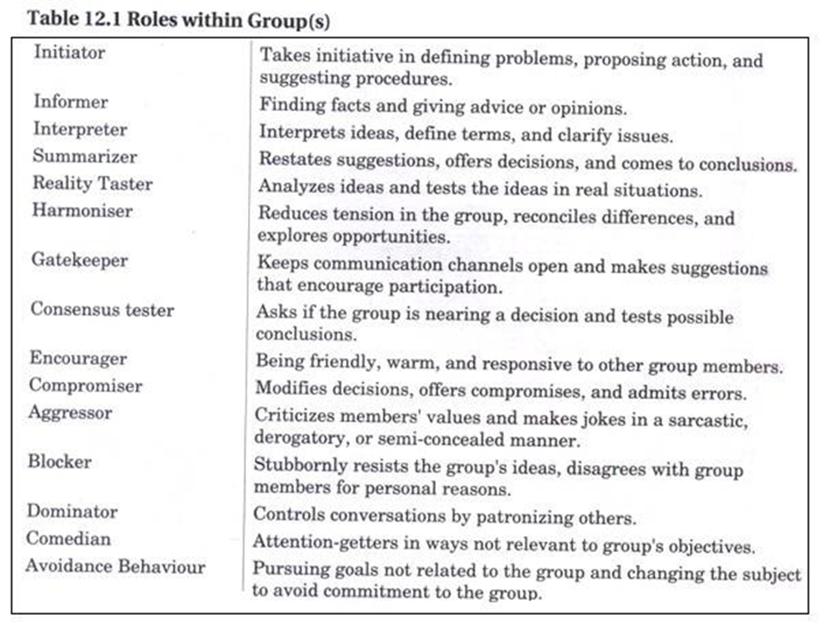
2. Group Structure:
Group Roles:

Slide 16
Group Size: Group size can vary from 2 people to a very large number of people. Small groups of two to ten are thought to be more effective
Group Norms:
Group Cohesiveness:
3. Group Processes: Decisions take longer time

Slide 17
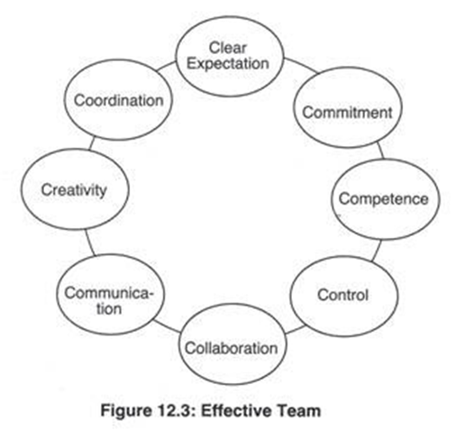
Turning Groups into Effective Teams:
All teams are groups but not all groups are teams.

